Slide 1
K Nearest Neighborhood (KNNs)
Lecture 16

Slide 2
KNN introduction
K Nearest Neighbor(KNN) is a very simple, easy to understand, versatile and one of the topmost machine learning algorithms.
KNN used in the variety of applications such as finance, healthcare, political science, handwriting detection, image recognition and video recognition.
KNN algorithm used for both classification and regression problems. KNN algorithm based on feature similarity approach.

Slide 3
1. Nearest Neighbor Classifiers
Basic idea:
If it walks like a duck, quacks like a duck, then it’s probably a duck
Compute Distance
Test Record
Training Records
Choose k of the “nearest” records

Slide 4
Nearest-Neighbor Classifiers
Requires three things
The set of stored records
Distance Metric to compute distance between records
The value of k, the number of nearest neighbors to retrieve
To classify an unknown record:
Compute distance to other training records
Identify k nearest neighbors
Use class labels of nearest neighbors to determine the class label of unknown record (e.g., by taking majority vote)

Slide 5
Definition of Nearest Neighbor
K-nearest neighbors of a record x are data points that have the k smallest distance to x

Slide 6
1. Overview of KNN Classifier
Instance based learning
K-NN = k nearest neighbors algorithm
Training phase consists only of storing the feature vectors and class labels of the training samples
K is a user-defined parameter
A test point is selected and distances from the test point to every point in the training set is calculated
Class label is assigned via majority vote of the k nearest neighbors to the test point

Slide 7
2. KNN Parameter Selection
Best choice for k value
Depends upon the data
Larger values generally reduce noise effects
But larger values make class boundaries less distinct
Can be selected via heuristic techniques
Can also use evolutionary algorithms to optimize k value

Slide 8
KNN Classifier: Parameter Selection
K-NN = k nearest neighbors algorithm
Training phase consists only of storing the feature vectors and class labels of the training samples
K is a user-defined parameter
A test point is selected and distances from the test point to every point in the training set is calculated
Class label is assigned via majority vote of the k nearest neighbors to the test point

Slide 9
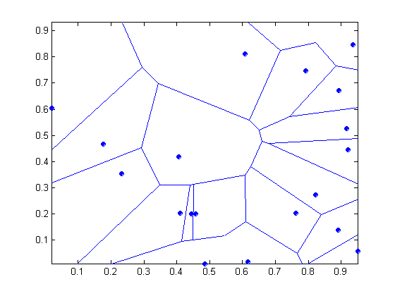
1 nearest-neighbor
Voronoi Diagram

Slide 10
Nearest Neighbor Classification…
Choosing the value of k:
If k is too small, sensitive to noise points
If k is too large, neighborhood may include points from other classes

Slide 11
2. KNN Distance Measure Selection
Choice of distance measure is important
Nearest neighbors can produce incorrect predictions unless appropriate proximity measures used and pre-processing steps taken
Scale of attributes must be taken into consideration to avoid domination by less important attributes

Slide 12
Nearest Neighbor Classification
Compute distance between two points:
Euclidean distance
Determine the class from nearest neighbor list
take the majority vote of class labels among the k-nearest neighbors
Weigh the vote according to distance
weight factor, w = 1/d²

Slide 13
Nearest Neighbor Classification…
Scaling issues
Attributes may have to be scaled to prevent distance measures from being dominated by one of the attributes
Example:
height of a person may vary from 1.5m to 1.8m
weight of a person may vary from 90lb to 300lb
income of a person may vary from $10K to $1M

Slide 14
Nearest Neighbor Classification…
Problem with Euclidean measure:
High dimensional data
curse of dimensionality
Can produce counter-intuitive results
1 1 1 1 1 1 1 1 1 1 1 0
1 0 0 0 0 0 0 0 0 0 0 0
vs
0 1 1 1 1 1 1 1 1 1 1 1
0 0 0 0 0 0 0 0 0 0 0 1
d = 1.4142
d = 1.4142
Solution: Normalize the vectors to unit length

Slide 15
Lazy vs Eager Learners
k-NN classifiers are lazy learners
It does not build models explicitly
Unlike eager learners such as decision tree
Classifying unknown records are relatively expensive

Slide 16
EAGER LEARNERS: Characteristics
Eager learners
Global model of entire input space
Long training time to develop model
Short time classifying test points

Slide 17
Characteristics of KNN
Pros
The training phase of K-nearest neighbor classification is much faster compared to other classification algorithms.
Decision boundaries can be of arbitrary shape = more flexible model representation
Uses local information to make predictions, quick in training.
Decision boundaries also highly variable
There is no need to train a model for generalization, That is why KNN is known as the simple and instance-based learning algorithm.
KNN can be useful in case of nonlinear data. It can be used with the regression problem.
Output value for the object is computed by the average of k closest neighbors value.

Slide 18
Cons
The testing phase of K-nearest neighbor classification is slower and costlier in terms of time and memory.
It requires large memory for storing the entire training dataset for prediction.
KNN requires scaling of data because KNN uses the Euclidean distance between two data points to find nearest neighbors. Euclidean distance is sensitive to magnitudes.
The features with high magnitudes will weight more than features with low magnitudes.
KNN also not suitable for large dimensional data.
The performance depends on the choice of distance formula

